Slide 1
Overview of Tuition Reciprocity Program
Policies and Procedures
Webinar Hosted by MnSCU
Presented by Ginny Dodds, OHE
March 1, 2010

Slide 2
Agenda
What is tuition reciprocity?
Which states have agreements?
Which campuses and programs are covered?
How are students approved for reciprocity?
How are campuses notified of approvals?
What tuition rates do campuses charge students?
How is term enrollment data reported?
How are interstate payments calculated?
Reciprocity contacts

Slide 3
What is Tuition Reciprocity?
Removes non-resident tuition barriers for students enrolled in public campuses in both states (or provinces)
Requires recipients be treated as residents for purposes of admission

Slide 4
Which States/Provinces Have Agreements?

Slide 5


Which Campuses/Programs Covered?
All public universities and colleges
Undergraduate programs
Graduate programs
Professional programs except:
Doctor of Medicine
Doctor of Veterinary Medicine
Doctor of Dental Sciences
Students enrolled in distance education classes delivered to home state from other state not covered
Students enrolled in programs that charge flat rate to all regardless of residency not covered if flat rate higher than resident rate
MN
WI

Slide 6

Which Campuses/Programs Covered?
All public universities and colleges
Undergraduate programs
Graduate programs
Professional programs except:
Doctor of Pharmacy
Juris Doctorate
Doctor of Medicine
Doctor of Veterinary Medicine*
Doctor of Dental Sciences*
ND
MN
*U of M reserves up to 5 slots per year in veterinary medicine and 10 slots per year in dental medicine for ND residents, but charges 75% of the non-resident rate. Dental rate becomes 100% of non-resident rate for the 2010-2011 academic year.

Slide 7

Which Campuses/Programs Covered?
MN
All public universities and colleges
Undergraduate programs
Graduate programs
Professional programs
SD

Slide 8
How are Students Approved?
WI residents attending MN universities and colleges apply to the Wisconsin Higher Educational Aids Board (HEAB)
On-line at:
www.heab.state.wi.us
Paper application mailed to
HEAB
Once approved by HEAB, student automatically renewed for future years if student earned credits in prior year
WI residents attending MN stand-alone technical colleges apply directly to college
Alexandria TC
Anoka TC
Dakota County TC
Hennepin TC
MN State Southeast TC
Northwest TC Bemidji
Pine TC
St. Cloud TC
St. Paul College
South Central College
MN residents attending WI universities and colleges apply to the MN Office of Higher Education
On-line at:
www.getreadyforcollege.org
Paper application mailed to
OHE
Once approved by OHE, student automatically renewed for future years if student earned credits in prior year
MN residents attending WI technical colleges apply directly to college
MN
WI
Application deadline is last day of term

Slide 9
How are Students Approved?
ND residents attending MN State CC&TC and MN State University Moorhead within one year of graduating from ND high school apply directly to campus (paperless application process)
ND residents attending other MN universities and colleges apply to ND University System or ND Dept of Career & Technical Education
On-line at:
www.ndus.edu or http://www.nd.gov/cte or
Mail paper application
Once approved by ND, student automatically renewed for future years if student earned credits in prior year
Data from ND on-line reciprocity applications is loaded to database at MN Office of Higher Education
MN residents who graduated from MN high school within one year of attending ND campus apply directly to ND campus (paperless application process)
Other MN residents attending ND universities and colleges apply to the MN Office of Higher Education
On-line at:
www.getreadyforcollege.org or
Mail paper application
Once approved by OHE, student automatically renewed for future years if student earned credits in prior year
ND
MN
Application deadline is last day of term

Slide 10
How are Students Approved?
SD residents attending University of MN campuses apply through SD Board of Regents
Mail paper application to SD Board of Regents
Once approved by SD, student automatically renewed for future years at U of M if student earned credits in prior year
SD residents attending MnSCU universities and colleges apply directly to MnSCU campus
MN residents attending SD universities and colleges apply directly to SD campus
MN
SD
Application deadline is last day of term

Slide 11
How are Campuses Notified of Approvals?
WI colleges and universities receive eligibility reports from MN Office of Higher Education (OHE)
Some WI colleges and universities receive downloadable eligibility data in electronic format
UW LaCrosse
UW Madison
UW River Falls
UW Superior
https://www.ohe.state.mn.us/SSL/ITRFiles/index.cfm
WI colleges and universities can also use OHE web student look-up screen:
https://www.ohe.state.mn.us/ssl/itr/index.cfm
WI technical colleges approve MN residents on campus, so don’t need eligibility reports
MN colleges and universities receive eligibility reports from Wisconsin Higher Educational
Aids Board (HEAB)
MN stand-alone technical colleges approve WI residents on campus, so don’t need eligibility reports
MN
WI

Slide 12
How are Campuses Notified of Approvals?
ND and MN colleges and universities receive eligibility reports from MN Office of Higher Education
Some MN colleges and universities receive downloadable eligibility data in electronic format
MN State CC & TC
University of MN
https://www.ohe.state.mn.us/SSL/ITRFiles/index.cfm
ND and MN colleges and universities can also use OHE student look-up screen:
https://www.ohe.state.mn.us/ssl/itr/index.cfm
ND
MN

Slide 13
How are Campuses Notified of Approvals?
All SD campuses approve MN residents on campus, so don’t need eligibility reports
All MnSCU campuses approve SD residents on campus, so don’t need eligibility reports
University of MN campuses receive downloadable eligibility data from OHE for SD residents in electronic format
https://www.ohe.state.mn.us/SSL/ITRFiles/index.cfm
University of MN campuses can also use OHE web student look-up screen:
https://www.ohe.state.mn.us/ssl/itr/index.cfm
MN
ND
SD

Slide 14
What Tuition Rates do Campuses Charge Students?
HEAB/UW System distributes official reciprocity rates to UW campuses
In general, reciprocity rate is the higher of the two states’ resident rates for the type of college attended
UM TC, Morris – UW Madison
UM Duluth – UW Milwaukee
State U’s – UW Comprehensives
CCs and Combined TC/CC - UW Colleges
In cases where reciprocity rate exceeds rate charged to other non-residents, reciprocity rate is capped at rate charged to other non-residents
MN undergraduates enrolled at WI campuses prior to 2008-2009 grandfathered through under previous reciprocity rate
MN resident rate at type of college attended
MN residents attending WI stand alone technical colleges pay WI resident rate
OHE distributes official reciprocity rates to MN campuses
In general, reciprocity rate is the higher of the two states’ resident rates for the type of college attended
UM TC, Morris – UW Madison
UM Duluth – UW Milwaukee
State U’s – UW Comprehensives
CCs and Combined TC/CC - UW Colleges
In cases where reciprocity rate exceeds rate charged to other non-residents, reciprocity rate is capped at rate charged to other non-residents
WI undergraduates enrolled at MN campuses prior to 2008-2009 grandfathered through under previous reciprocity rate
WI resident rate at type of college attended
WI residents attending MN stand-alone technical colleges pay MN resident rate
MN
WI

Slide 15
What is the Reciprocity Supplement?
WI undergraduates who began enrollment at MN campuses 2008-2009 or thereafter are charged the higher of the two states’ rates
This results in much higher rates for WI undergraduates, since the highest rate is typically the MN rate and they would have been charged the lower WI resident rate under the old agreement
State of Wisconsin offers supplement to bridge the difference between the higher MN resident rate and the lower WI resident rate
WI undergraduates at MN campuses end up being billed the net reciprocity rate (MN resident rate minus supplement)
MN campuses bill HEAB for total supplement payments after the end of each term
MN
WI
Winona SU Res Rate $5941
WI Supplement - $ 330
Net Tuition Charged $5611

Slide 16
What Tuition Rates do Campuses Charge Students?
ND University System distributes official reciprocity rates to ND campuses
In general, reciprocity rate is the higher of the two states’ resident rates for the type of college attended
NDSU and UND charge the average MN State University undergraduate and graduate rates
Occupational Therapy charges the ND resident rate
Dickinson, Mayville, Minot and Valley City charge slightly more (4.5% for 2009-2010) than the ND resident rate for undergraduate and MN resident rate for graduate
ND two-year campuses charge average MN two-year resident rate
OHE distributes official reciprocity rates to MN campuses
In general, reciprocity rate is the higher of the two states’ resident rates for the type of college attended
This has historically been the MN resident rate for all MN campuses and programs
University of MN charges 75% of non-resident rate to ND residents in reserved slots for veterinary medicine and dental medicine
This increases to 100% of non-resident rate for dental medicine effective 2010-2011 academic year
ND
MN

Slide 17
What Tuition and Fee Rates do Campuses Charge Students?
SD Board of Regents distributes official reciprocity rates to SD campuses
In general, reciprocity rate is the higher of the two states’ resident rates for the type of college attended
SD four-year universities charge the average MN four-year (state universities, UM Crookston & Duluth) undergraduate and graduate rates
SD professional programs charge the higher of the MN professional program resident rate or 150% of the SD professional program resident rate
SD technical colleges charge MN residents the SD resident rate
OHE distributes official reciprocity rates to MN campuses
In general, reciprocity rate is the higher of the two states’ resident tuition and fee rates for the type of college attended
U of MN campuses charge MN resident tuition and fees
About half of MN state universities charge MN resident tuition and fee rate, and half charge the SD resident tuition and fee rate
MN community and consolidated colleges charge the MN resident tuition (plus surcharge – 16.3% for 2009-2010) and fees
MN stand alone technical colleges charge SD residents the MN resident rate
MN
MN
SD

Slide 18
How is Term Enrollment Data Reported?
After term ends, OHE sends email to WI campuses asking them to report term enrollment data for MN residents enrolled at WI campuses
Some WI campuses submit term enrollment data electronically by sending a file via FTP
Eau Claire, LaCrosse, Madison, River Falls, Stout, Superior
Remaining WI campuses enter term enrollment data on OHE’s term enrollment data web screen
https://www.ohe.state.mn.us/ss/itr/index.cfm
University of Wisconsin Colleges office reports for all community colleges
WI technical colleges do NOT report term enrollment data to OHE, since it is not used in the payment calculation
After term ends, HEAB asks MN campuses to report term enrollment data for WI residents enrolled at MN campuses
Some MN campuses submit term enrollment data electronically
University of MN
MnSCU will begin this process for 2010-2011
Other MN campuses provide term enrollment data on spreadsheets generated by HEAB and uploaded via secure web site
MN stand-alone technical colleges do NOT report term enrollment data to HEAB, since it is not used in the payment calculation
MN
WI

Slide 19
How is Term Enrollment Data Reported?
After term ends, OHE sends email to NDUS system office asking programmer to submit a file of paperless application data and a file of term enrollment data to OHE for MN residents enrolled at all ND campuses.
NDUS system office uploads both data files to OHE’s secure file upload site: https://www.ohe.state.mn.us/SSL/ITRFiles/index.cfm
OHE loads paperless application data file to its reciprocity database, followed by the term enrollment data file
OHE reciprocity staff contact ND campuses about any rejected records
SSN mismatches
Student not approved
State of residence not = MN
After term ends, OHE sends emails to MnSCU system office and University of MN asking programmers to submit a file of term enrollment data to OHE for ND residents enrolled at all of their campuses.
MnSCU and U of M upload their data files to OHE’s secure file upload site: https://www.ohe.state.mn.us/SSL/ITRFiles/index.cfm
MN State Univ Moorhead sends paperless application file to OHE
OHE loads the data files to its reciprocity database
OHE reciprocity staff contact MN campuses about any rejected records
SSN mismatches
Student not approved
State of residence not = ND
MN
ND
WI
MN

Slide 20
How is Term Enrollment Data Reported?
After term ends, OHE sends email to SD Board of Regents office asking programmer to submit a file of combined application and term enrollment data to OHE for MN residents enrolled at all SD campuses.
SDBOR office uploads the combined application and term enrollment data to OHE’s secure file upload site: https://www.ohe.state.mn.us/SSL/ITRFiles/index.cfm
OHE loads combined application and term enrollment data file to its reciprocity database
OHE reciprocity staff contact SD campuses about any rejected records
SSN mismatches
Student not approved
State of residence not = MN
After term ends, OHE sends emails to MnSCU system office and University of MN asking programmers to submit data files to OHE for SD residents enrolled at all of their campuses.
MnSCU submits a combined application and term enrollment file
U of M submits term enrollment files
https://www.ohe.state.mn.us/SSL/ITRFiles/index.cfm
OHE loads the data files to its reciprocity database
OHE reciprocity staff contact MN campuses about any rejected records
SSN mismatches
Student not approved
State of residence not = SD
MN
SD
MN

Slide 21
What Gets Reported in Paperless Application File? (used by ND campuses and MN State Univ Moorhead)
File Identifier
School’s Federal School Code
Student SSN
Student Name
Student Address
Student Date of Birth
Reciprocity Application Date
Student’s high school state
Student’s high school graduation date*
*High school graduation date must be within one year of fall term enrollment at college (e.g., 2009 for 2009-2010 academic year)

Slide 22
What Gets Reported in Term Enrollment Data File?
File Identifier
Term Code
School’s Federal School Code
Student SSN
Student Name
Student’s Class Level
Student’s Undergraduate Credits
Student’s Graduate Credits
Student’s Professional Credits
Student’s Undergraduate Tuition Charges (WI/MN only)
Student’s Graduate Tuition Charges (WI/MN only)
Student’s Professional Tuition Charges (WI/MN only)

Slide 23
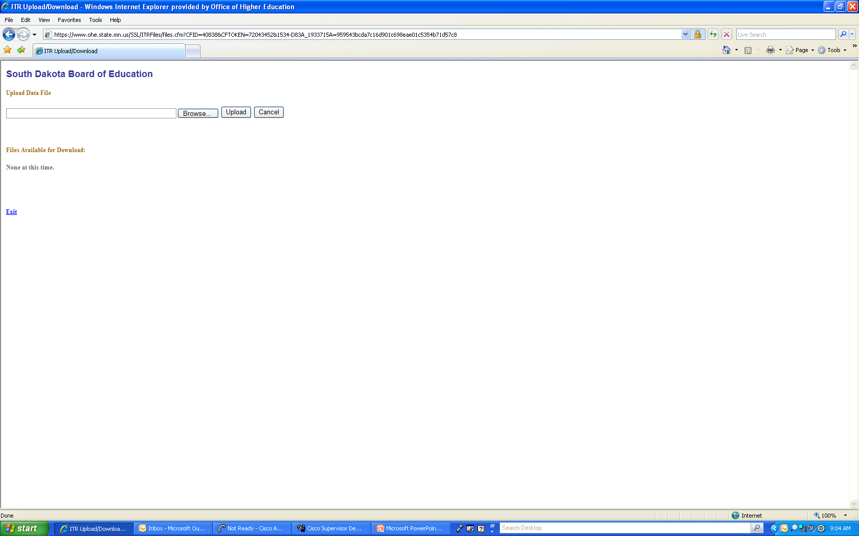
Term Enrollment File Upload Screen

Slide 24
What Gets Entered on Term Enrollment Web Page at OHE?
File Identifier
Term Code
School’s Federal School Code
Student SSN
Student Name
Student’s Class Level
Student’s Undergraduate Credits
Student’s Graduate Credits
Student’s Professional Credits
Student’s Undergraduate Tuition Charges (WI only)
Student’s Graduate Tuition Charges (WI only)
Student’s Professional Tuition Charges (WI only)
Pre-populated on screen

Slide 25
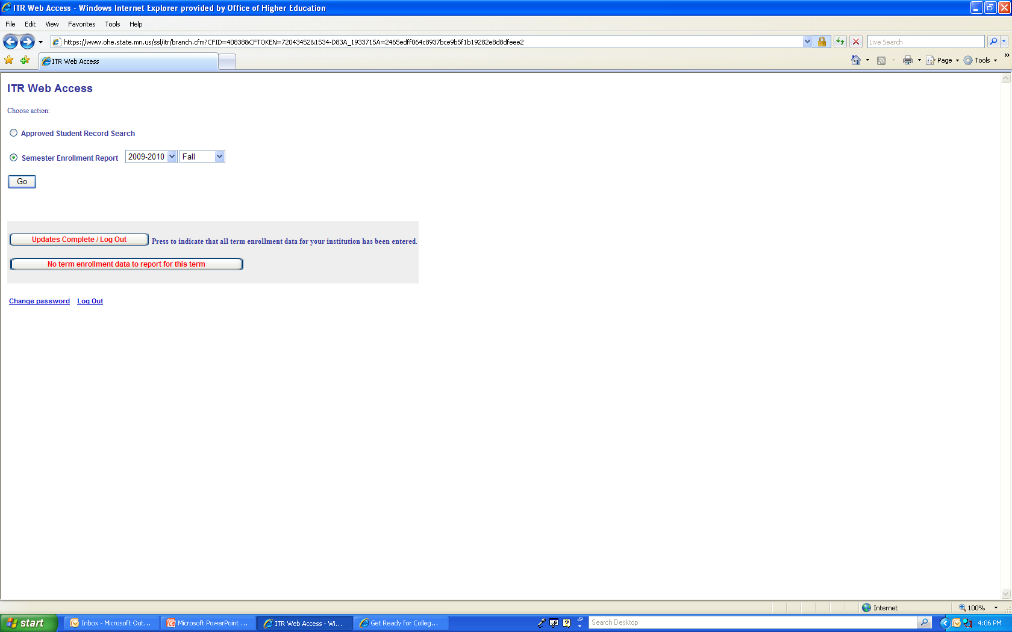
OHE Term Enrollment Screen

Slide 26
Who Should be Included in Term Enrollment Reporting?
 | WI/MN | ND/MN | SD/MN
Students at stand-alone technical colleges | NO | YES | NO
Students in study abroad program *if registered through college reporting data | YES* | YES* | YES*
Students who withdrew *report if student withdrew after 100% refund period) | YES* | YES* | YES*
Students in exclusively distance education programs delivered to home state from reciprocity state (or students taking classes in home state at satellite campus in home state) | NO | YES | YES
Students in professional programs | Law, pharmacy, OT | U of M – Vet Med, Dental | All professional programs
Students in programs charging flat rate to all regardless of residency status, when flat rate > resident rate | NO | NO | NO
Students never subject to non-resident rate because tuition paid by third party (ROTC, employer) | NO | NO | NO
Credits with W, I, F, NC, P/F grades | YES | YES | YES

Slide 27
How are Payments Calculated?
2008-2009 Minnesota Payment to North Dakota
ND instructional cost per FTE |  | $10,577
Marginal rate | X | .64
Marginal instructional cost per FTE | = | $6,769
ND resident tuition rate | - | $5,270
Remaining marginal cost per FTE | = | $1,499
GAP FTE | X | 3,338
Gross MN liability | = | $5,003,662
Tuition paid by MN residents in excess of ND rate | - | $1,924,884
Net MN Liability to ND | = | $3,078,778
ND
MN

Slide 28
How are Payments Calculated?
2008-2009 WI/MN Payment Calculation (shown for UW River Falls)
Instructional Cost per Credit |  | $301.03
Marginal Rate | X | .64
Marginal Instructional Cost per Credit | = | $192.66
Number of Credits | X | 40,370.5
Gross Marginal Instructional Costs | = | $7,777,780.53
Reciprocity Tuition Paid | - | $7,570,131.99
MN Liability to WI | = | $207,648.54
MN
WI

Slide 29
Reciprocity Contacts (for Campus Reciprocity Administrators)
ND University System
Deanna Dailey
(701) 328-4113
Deanna.dailey@ndus.edu
MN Office of Higher Ed
Jodi Rouland
(651) 355-0614
Jodi.Rouland@state.mn.us
Ginny Dodds
(651) 355-0610
Ginny.Dodds@state.mn.us
WI Higher Ed Aids Board
Cindy Lehrman
(608) 267-2209
Cindy.lehrman@wisconsin.gov
SD Board of Regents
Joella Anderson – SDSU
(605) 688-4497
Joella.anderson@sdstate.edu
Today’s training materials downloadable from:
http://www.ohe.state.mn.us/mPg.cfm?pageID=813

Slide 30

Questions???????????????

